Slide 1
Creating tickets

Slide 2
Remedy ITSM

Slide 3
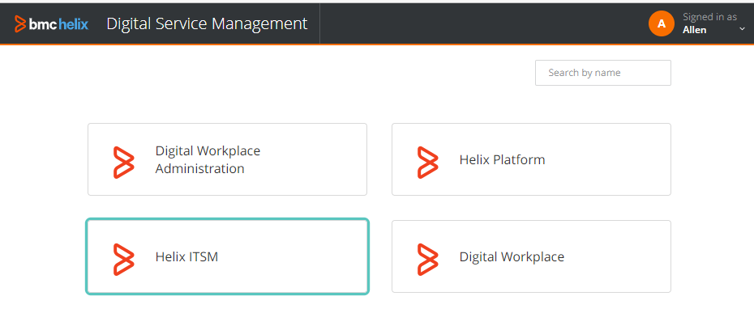
Menu (using Helix ITSM)

Slide 4
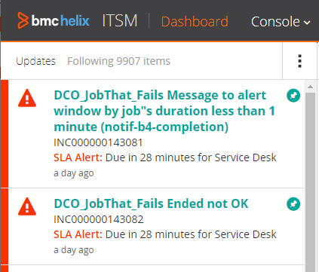
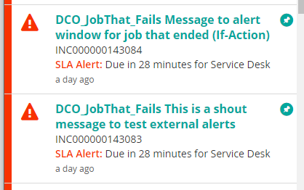
Different types of notifications

Slide 5
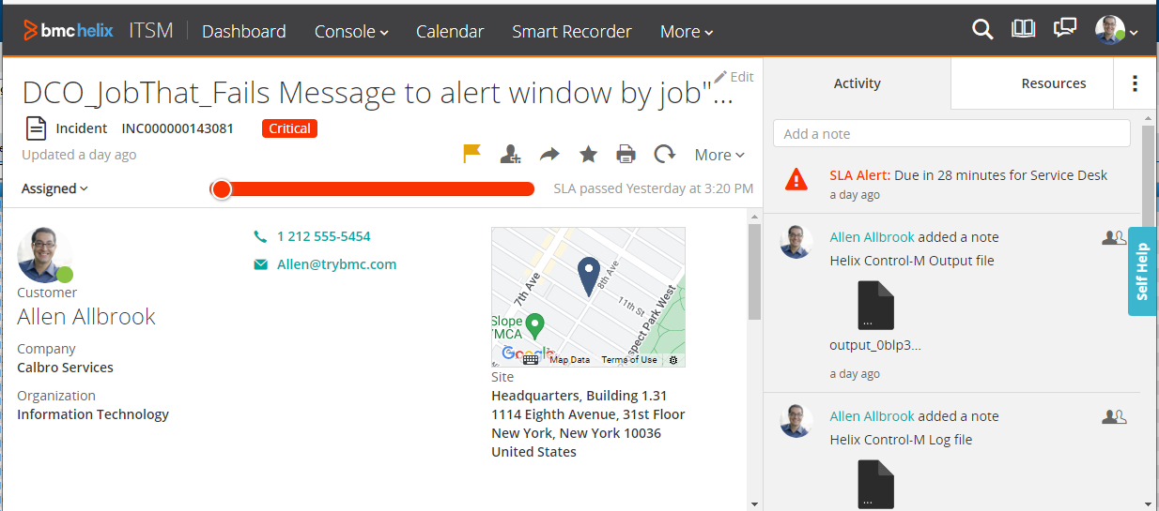
Display a ticket with output and log

Slide 6
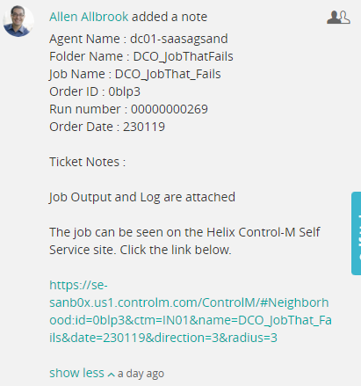
Note in the case with URL

Slide 7

Using Mid-Tier

Slide 8
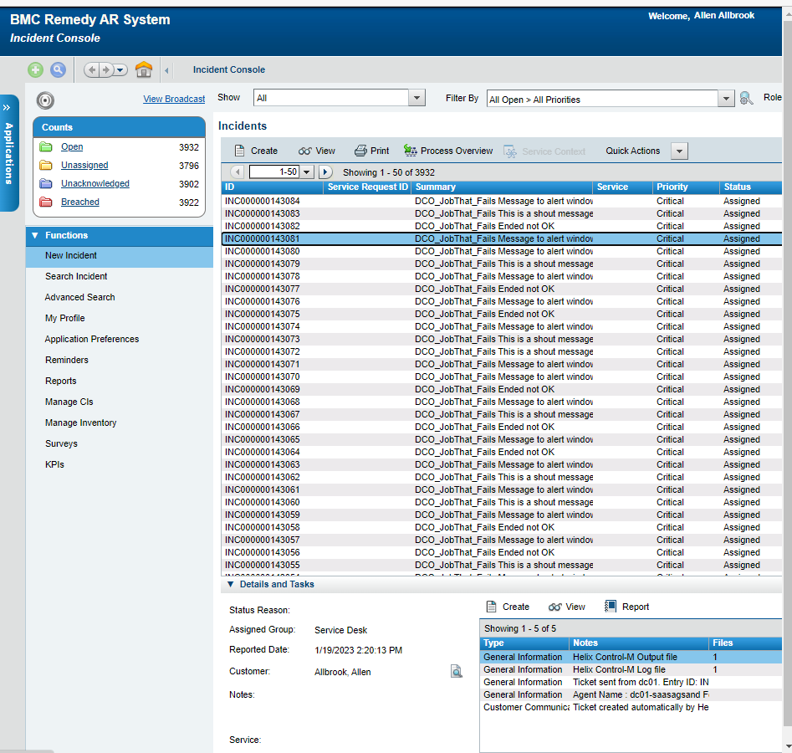
All incidents

Slide 9

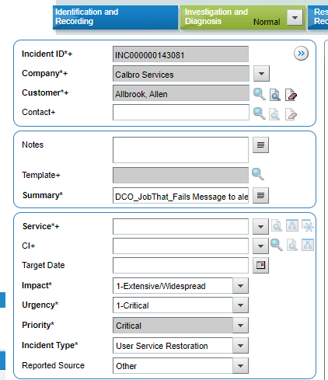


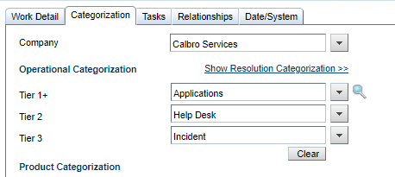
Incident details

